Slide 1
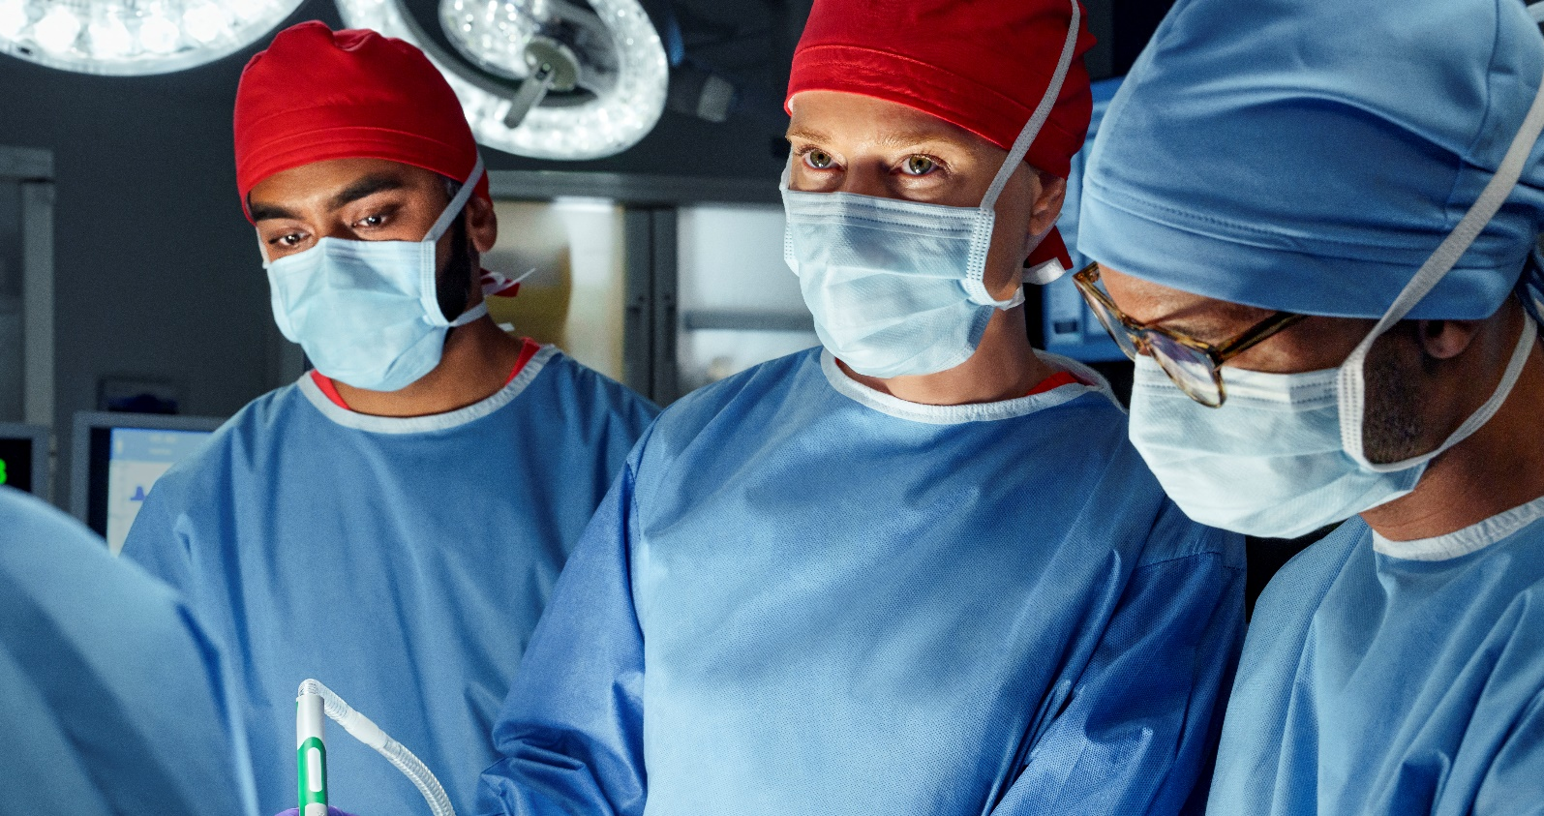
October 24-25, 2024
Bangkok Dusit Medical Services PLC.
2 Soi Soonvijai 7,
New Phetchaburi Road, Bangkok 10310 Thailand
Complex intra-articular fractures of the upper and lower extremities, polytrauma. Methods of treatment
Program agenda |  | Faculty
Day 1, October, 24
9.00 | Welcome by Director of BIH and Introduction of Guests
9.15 | BDMS Hospital Net work, patient flow | Dr. Suthorn Bavornratanavech
9.45 | COE Orthopedic | Dr. Vajara Phiphobmongkol
10.00 | Case discussion | Dr. Vajara Phiphobmongkol
10:30 | Live Surgery | Dr. Suthorn Bavornratanavech
12.30 | Lunch
13.30 | Live Surgery | Dr. Vajara Phiphobmongkol
15.30 | Break
16.00 | Live Surgery | Dr. Suthorn Bavornratanavech
18.00 | End of Day 1

Slide 2
October 24-25, 2024
Bangkok Dusit Medical Services PLC.
2 Soi Soonvijai 7,
New Phetchaburi Road, Bangkok 10310 Thailand
Complex intra-articular fractures of the upper and lower extremities, polytrauma. Methods of treatment
Program agenda |  | Faculty
Day 2, October, 25
9.00 | Hospital Tour
9.30 | Case discussion | Dr. Vajara Phiphobmongkol
10.30 | Live Surgery | Dr. Suthorn Bavornratanavech
12.30 | Lunch
13.30 | Live Surgery | Dr. Vajara Phiphobmongkol
15.30 | Break
16.00 | Live Surgery | Dr. Suthorn Bavornratanavech
18.00 | End of Day 2. Summary of visit

